Slide 1
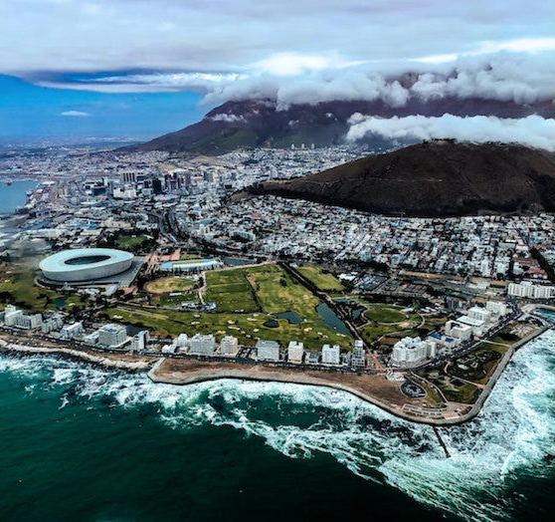
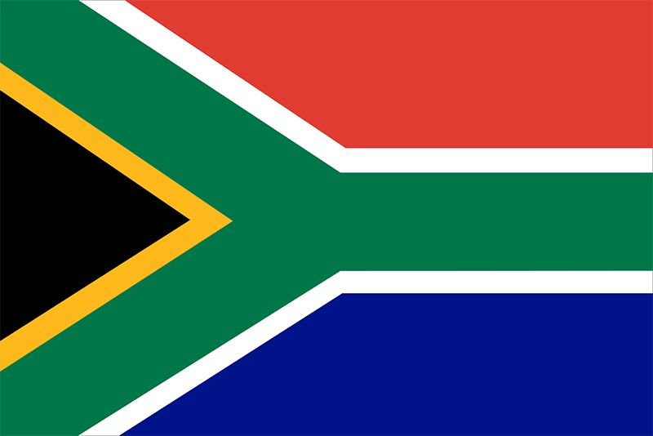
Global Public Relations:
South Africa
By: Mekhi-el Stevens

Slide 2


Public Relations Industry
Most developed PR market in Africa
  Highly competitive media environment (Eminence Global)
  Sustainable, established PR environment
  Thriving media and social media ecosystem
Public Relations Institute of Southern Africa (PRISA) is the only professional body
PR firms greatly assist in growing platforms/organization
CSR emphasis, addressing issues such as: environmental sustainability, inequality and unemployment

Slide 3
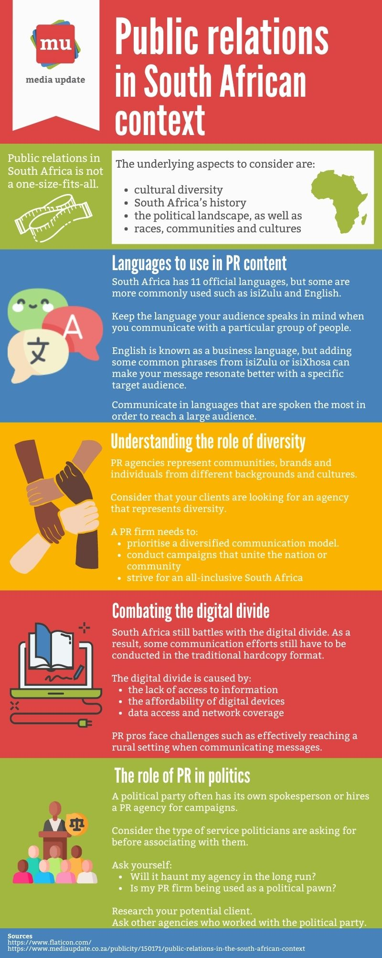
Relationships
Media
  Strong journalism (interviews, magazines, etc.)
  High social media / internet penetration (top 20 social media usage in the world)
  Radio use
Agency Culture
  Coined as most sophisticated PR in Africa
  Built on professionalism
  Communication heavy and emphasis on relationship building
Ways of Working
  Localization
  Take advantage of media outlets
  Focus to be ethical in practice

